Slide 1

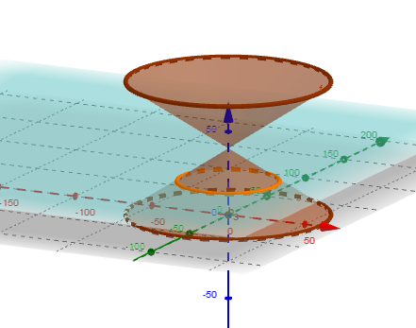
Frustum of cone on Geogebra
Different Geometric shapes can be studied just with the help of a cone and a cutting plane like
Point
Circle
Ellipse
Parabola
Hyperbola

Slide 2
Lets See frustum of cone and its animation on Geogebra

